Slide 1
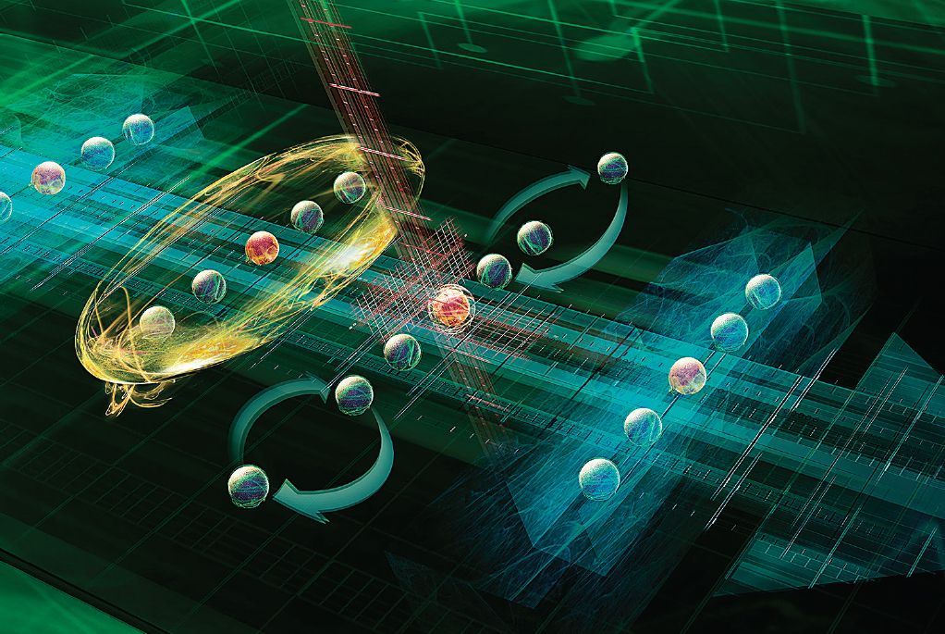
Quantum Weirdness: Exploring Quantum Error Correction
Andry Paez

Slide 2
What we will be covering

Slide 3
What we will be covering.
Quantum Computing and Error Correction Codes

Slide 4
What we will be covering..
Quantum Computing and Error Correction Codes
Implementation

Slide 5
What we will be covering…
Quantum Computing and Error Correction Codes
Implementation
Results

Slide 6
What is Quantum Computing?

Slide 7
What is Quantum Computing?
Quantum computing is a revolutionary approach that leverages the principles of quantum mechanics to solve problems far beyond the capabilities of classical computers.

Slide 8
What is Quantum Computing?
Quantum computing is a revolutionary approach that leverages the principles of quantum mechanics to solve problems far beyond the capabilities of classical computers.
Classical computers struggle with problems like simulating molecules or optimizing large systems.

Slide 9
What is Quantum Computing?
Quantum computing is a revolutionary approach that leverages the principles of quantum mechanics to solve problems far beyond the capabilities of classical computers.
Classical computers struggle with problems like simulating molecules or optimizing large systems.
Quantum computers can explore many possibilities simultaneously, offering exponential speedup for certain tasks.

Slide 10
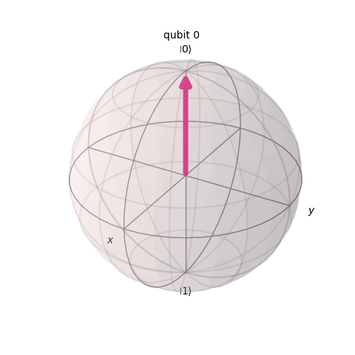
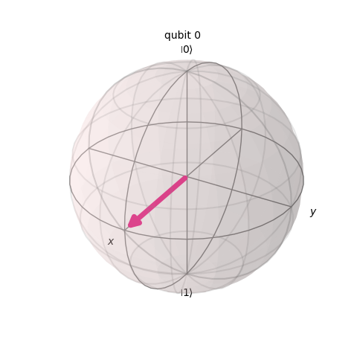
What is a Qubit?

Slide 11
What is a Qubit?
A qubit is like a spinning coin—it’s not just heads (0) or tails (1) but a blend of both at once.

Slide 12
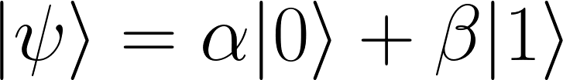
What is a Qubit?
A qubit is like a spinning coin—it’s not just heads (0) or tails (1) but a blend of both at once.
Superposition: Qubits can be in multiple states at once.

Slide 13
What is a Qubit?
A qubit is like a spinning coin—it’s not just heads (0) or tails (1) but a blend of both at once.
Superposition: Qubits can be in multiple states at once.
Entanglement: Qubits can share information across distances instantly, enabling powerful correlations.

Slide 14
What is a Qubit?
A qubit is like a spinning coin—it’s not just heads (0) or tails (1) but a blend of both at once.
Superposition: Qubits can be in multiple states at once.
Entanglement: Qubits can share information across distances instantly, enabling powerful correlations.

Slide 15
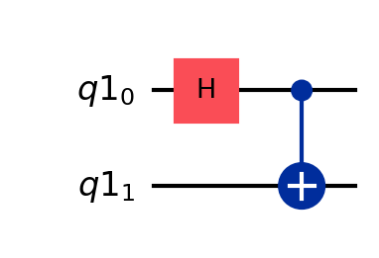
The Quantum Circuit

Slide 16
The Quantum Circuit
A quantum circuit is a visual representation of the steps required to manipulate qubits and perform quantum computations. It is the blueprint for quantum algorithms.

Slide 17
The Quantum Circuit
A quantum circuit is a visual representation of the steps required to manipulate qubits and perform quantum computations. It is the blueprint for quantum algorithms.
Qubits are horizontal lines
Quantum gates manipulate qubits to perform operations like creating superposition, entanglement, or flipping bits.

Slide 18
The Quantum Circuit
Key Quantum Gates:

Slide 19
The Quantum Circuit
Key Quantum Gates:
Hadamard
Pauli X, Y, Z, I
CNOT
Measurement
Toffoli

Slide 20
Quantum Error

Slide 21
Quantum Error
Bit-Flip Errors (Pauli-X)
Phase-Flip Errors (Pauli-Z)

Slide 22
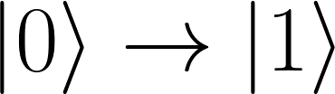
Quantum Error
Bit-Flip Errors (Pauli-X)
Flips the state of a qubit
Phase-Flip Errors (Pauli-Z)

Slide 23

Quantum Error
Bit-Flip Errors (Pauli-X)
Flips the state of a qubit
Phase-Flip Errors (Pauli-Z)
Flips the probabilities of a qubit

Slide 24
Quantum Error Correction Codes

Slide 25
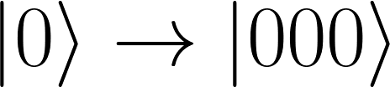
Quantum Error Correction Codes
Encoding: the process of converting a logical qubit into multiple physical qubits to protect it from errors.

Slide 26
Quantum Error Correction Codes
Encoding: the process of converting a logical qubit into multiple physical qubits to protect it from errors.
Decoding: reverses the encoding process to retrieve the logical qubit's state from the physical qubits.

Slide 27
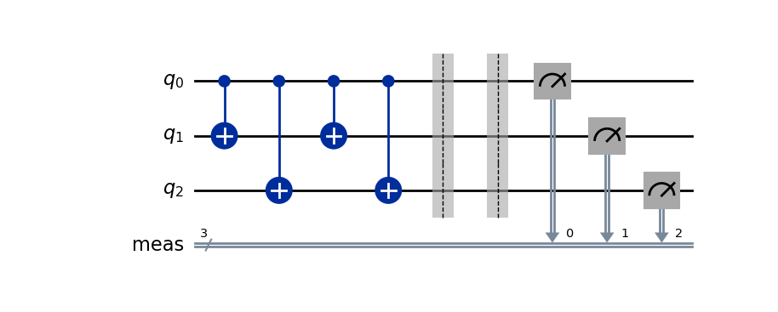
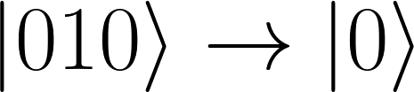
3-Bit Repetition Code

Slide 28
3-Bit Repetition Code
The 3-Bit Repetition Code is a simple error correction scheme that protects quantum information by encoding one logical qubit into three physical qubits. It helps correct single bit-flip errors by leveraging redundancy.

Slide 29
3-Bit Repetition Code
The 3-Bit Repetition Code is a simple error correction scheme that protects quantum information by encoding one logical qubit into three physical qubits. It helps correct single bit-flip errors by leveraging redundancy.
Doesn’t correct phase-flips or multi bit-flip errors

Slide 30
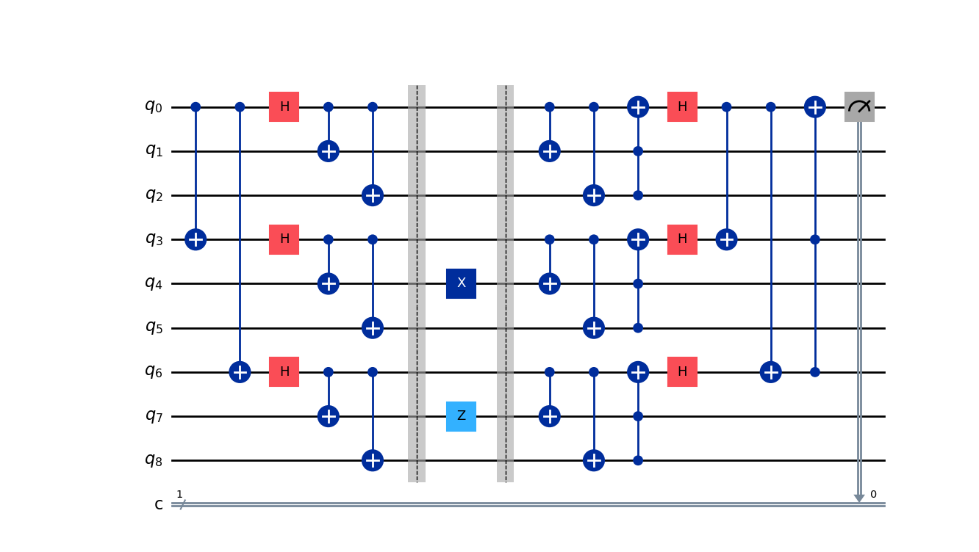
Shor’s Code

Slide 31
Shor’s Code
Shor's Code redundantly encodes one logical qubit into nine physical qubits across three groups, combining bit-flip protection (like the 3-bit repetition code) with phase-flip protection using Hadamard and CNOT gates, ensuring correction of any single-qubit error.

Slide 32
Shor’s Code
Shor's Code redundantly encodes one logical qubit into nine physical qubits across three groups, combining bit-flip protection (like the 3-bit repetition code) with phase-flip protection using Hadamard and CNOT gates, ensuring correction of any single-qubit error.
This makes it one of the first examples of a fault-tolerant quantum error-correcting code.

Slide 33
Simulation vs. Reality

Slide 34
Simulation vs. Reality
Simulated Environment: Used controlled noise models in Qiskit to introduce bit-flip and phase-flip errors, allowing testing of error correction techniques.

Slide 35
Simulation vs. Reality
Simulated Environment: Used controlled noise models in Qiskit to introduce bit-flip and phase-flip errors, allowing testing of error correction techniques.
Real Quantum Hardware: Tested circuits on IBM quantum computers where inherent noise is unpredictable and comes from environmental and hardware limitations, providing a practical eval of error correction performance.

Slide 36
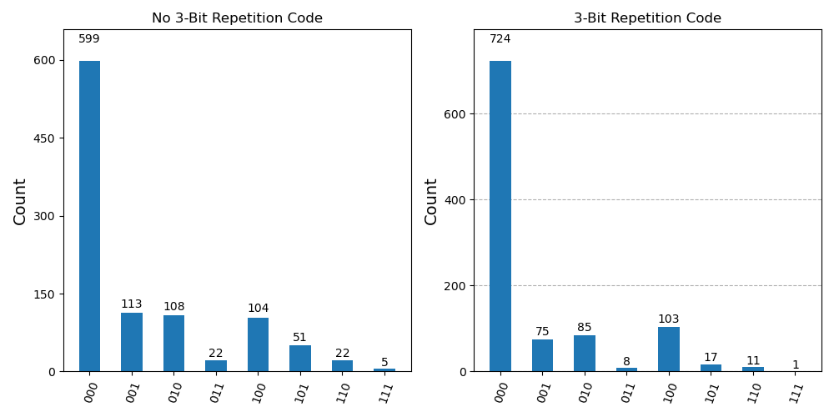
3-Bit Repetition Code Results

Slide 37
3-Bit Repetition Code Results
Without error correction: Fidelity was 90.2%, with an error rate of 9.77%.

Slide 38
3-Bit Repetition Code Results
Without error correction: Fidelity was 90.2%, with an error rate of 9.77%.
With the 3-bit repetition code: Fidelity improved to 96.4%, reducing the error rate to 3.61%.
Demonstrated effective correction of single bit-flip errors but was unable to address phase-flip errors.

Slide 39
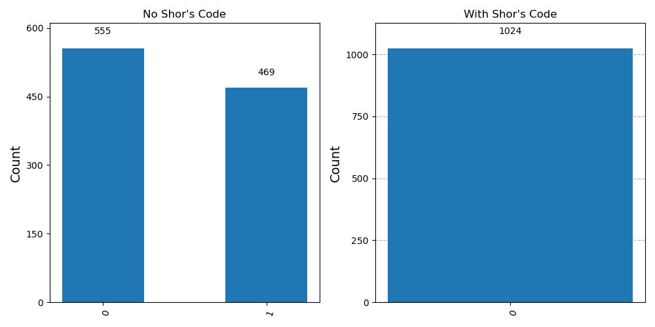
Shor’s Code (Simulation) Results

Slide 40
Shor’s Code (Simulation) Results
Without error correction: Fidelity was 54.2%, with an error rate of 45.8%

Slide 41
Shor’s Code (Simulation) Results
Without error correction: Fidelity was 54.2%, with an error rate of 45.8%.
With Shor's Code: Achieved perfect fidelity (100%) by correcting all single bit-flip and phase-flip errors in the simulated noise environment.
Demonstrated the theoretical power of Shor's Code in an idealized setup.

Slide 42
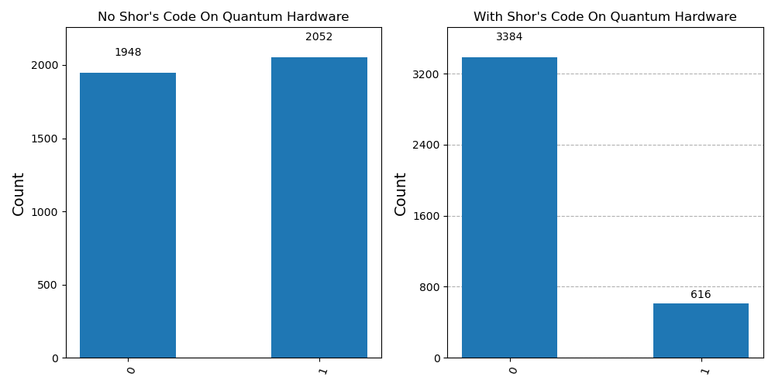
Shor’s Code Results

Slide 43
Shor’s Code Results
Without error correction: Fidelity was 48.7%, with an error rate of 51.3%.

Slide 44
Shor’s Code Results
Without error correction: Fidelity was 48.7%, with an error rate of 51.3%.
With Shor's Code: Fidelity improved to 84.6%, reducing the error rate to 15.4%.
Showcased significant noise reduction on real quantum hardware, though hardware limitations like gate fidelity and decoherence constrained performance.

Slide 45
Conclusion
Shor's Code successfully corrected both bit-flip and phase-flip errors, showcasing its robustness in simulations and real hardware.

Slide 46
Conclusion
Shor's Code successfully corrected both bit-flip and phase-flip errors, showcasing its robustness in simulations and real hardware.
Simulations achieved perfect fidelity, but real hardware highlighted limitations due to noise and gate imperfections.

Slide 47
Conclusion
Shor's Code successfully corrected both bit-flip and phase-flip errors, showcasing its robustness in simulations and real hardware.
Simulations achieved perfect fidelity, but real hardware highlighted limitations due to noise and gate imperfections.
Demonstrates the critical role of quantum error correction in advancing reliable quantum computing.

Slide 48
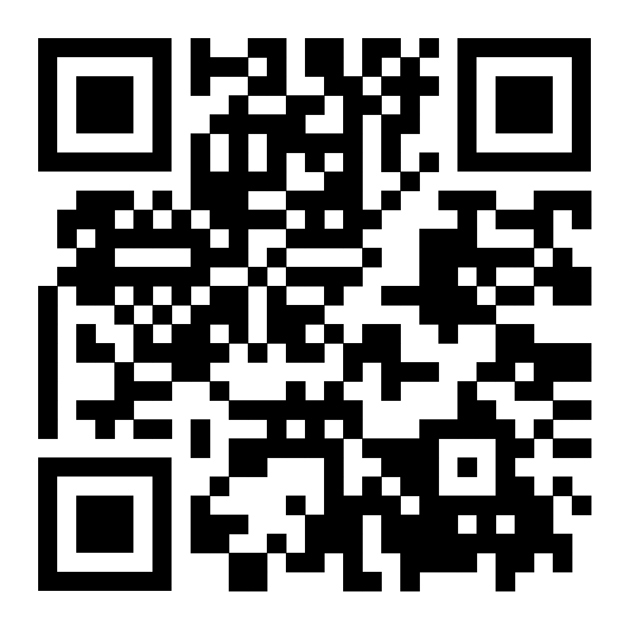

Thank You!

